Slide 1
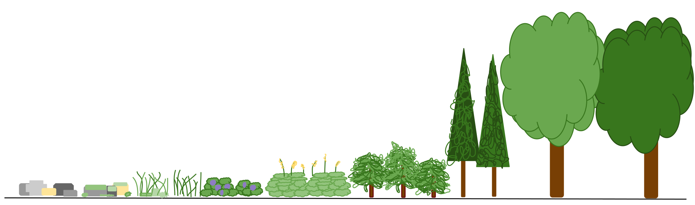
Warm Up: 3/1/2016
In the picture below what is being shown?
*hint: think about what we learned yesterday

Slide 2
Succession & Ecological Relationships
Part 2

Slide 3
Objectives
Apply knowledge from previous lessons to complete the student worksheet with 80% accuracy.
Create ecological relationships between imaginary organisms by applying what they have learned in class with 80% accuracy.

Slide 4
Review
What is ecological succession?
The gradual process by which ecosystems change and develop over time
Primary Succession
Changes that occur on a brand new habitat
Secondary Succession
Changes that take place on a previously colonized, but damaged habitat

Slide 5
Ecological Relationships
What is symbiosis?
The close relationship of two dissimilar organisms
Mutualism
A symbiotic relationship where both organisms benefit
Commensalism
A symbiotic relationship where one organism benefits and the other does not benefit but is unharmed
Parasitism
A symbiotic relationship where one organism benefits and one is harmed

Slide 6
Examples
Bees pollenating the cacti and depending on it for food
Mutualism
Fleas living on the bodies of coyotes and other animals
Parasitism
A desert holly shrub provides shade for young creosote brush
Commensalism

